Slide 1
Welcome to Year 3
Miss Roseby Miss Dixon
Mrs Hart Mrs Knighton
Both classes… Mrs Mitchell

Slide 2
Uniform
Black trousers or skirts
White polo shirts
Blue jumper
Black shoes
No large headbands and bows
If any part of the school uniform is missing for any reason, please leave a message or let us/ gate staff know.

Slide 3
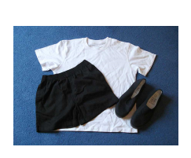
PE Kit
Black/Navy Shorts
Black/Navy jogging bottoms (plain)
White polo shirt
Children should not wear leggings (school policy)
Trainers or pumps – Run a Mile
Swimming in Spring

Slide 4
Dinner Money
Dinners are no longer free for your child now they are in KS2.
Meals are £2.30
Money must be paid on Parent Pay.
If money is not received in time then children will be given a sandwich and piece of fruit. They will not receive the school meal that day.
Healthy Snack
Must be a piece of fruit/ vegetable.

Slide 5
First Aid/ Medicines
Only medicines prescribed from a doctor can be administered by school staff.
Boxes or bottles must be labelled with the doctor’s prescription (name/date/amount).
Anything else must be administered by parents and carers.

Slide 6
Attendance/ Behaviour
We are trying hard to raise attendance in our school.
Making sure your child is on time allows them to settle and socialise before the school day starts.
Behaviour
-Positive rewards – class dojo points
-Reminders to stay on task
-Golden Rules, internal 5 minute exclusion from class.
-If behaviour continues then parents will be informed.

Slide 7
Homework and Reading
5 times a week reading for 15 minutes.
Reading Records will be checked on Fridays.
Spellings – overview will be in homework books. Children get 10 spellings a week.
Weekly spelling quizzes on a Thursday.
Times table of the week – in and out of order, related division facts, in context questions. Times tables will be repeated.
Year 4 Times Table Assessment.
Times tables will be monitored (regular quizzes).
Topic Grid – Extra voluntary tasks (Homework survey)

Slide 8
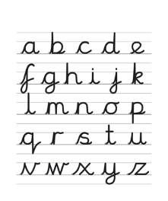
Handwriting
“Letter Join” is our handwriting programme.
It is a cursive style.
Most letters start at the bottom.
Children in Year 3 are expected to join.
It will take time to see an improvement.
Please encourage cursive writing during homework.

Slide 9
School Trips
Children will go on 3 school trips over the year and complete village walks.
Due to funding we can longer run school trips without full donations.
If £5 per child is not received there is a possibility that the trip will not take place.

Slide 10
Home School Reviews and Questions
HSR will be in the next couple of weeks.
Please leave a note in the mornings for any concerns and queries.
Reading Records can be used.
It can be difficult for us to ring in a school day.
Conversations at the end of the day are welcomed but can be difficult due to teachers making sure children are leaving with the correct people.

Slide 11
Any Questions?

