Slide 1
Year 6 Expectations
A School Presentation to Parents

Slide 2
Attitude
A good attitude to school life is essential. Doing just enough to get by is not good enough. We need to prepare, and demonstrate, to the children that you can succeed as long as you are determined and prepared to persevere.
In Year 6 social pressures increase as children become more socially aware. Minor disagreements can be blown out of proportion as children can express themselves (and put spin on) their views by using advanced vocabulary. If an adult at school believes an issue is serious enough you will receive a phone call.
Please be mindful of social media use by children. This is a rapidly growing area of concern. Be mindful of age restrictions and supervision is essential. Year 6 children will actively avoid their activities from being detected.

Slide 3
Attitude
Only medicines prescribed by a doctor and with an official label can be administered at school. Parents are welcome to come in and administer Calpol or other remedies during the school day.
Mobile phones in school can be incredibly disruptive and we have seen a noticeable rise in them being used as status symbols or as anything else other than as a phone. If a mobile is brought into school it needs to be placed in a special box in the classroom and not touched until the end of the day.
The school will hold no responsibility for phones brought into school.
Bikes and scooters should not be ridden near pedestrians - the Minpin’s path is too narrow.

Slide 4
Uniform
Year 6 children are the oldest in the school and are given extra responsibilities to prepare them for secondary school and life in general. This gives them confidence which can lead to them pushing boundaries.
This can manifest itself in the form of pushing what is acceptable uniform. Footwear is often an area – black is required. Year 6 children quite often use the argument that someone ‘else was allowed to…’
PE kit is an area where slight pushing of the boundaries can occur – white t-shirts with small logos. This is not acceptable. The correct PE kit is black shorts, white t-shirt and trainers. A jumper can be brought for particularly cold days.

Slide 5
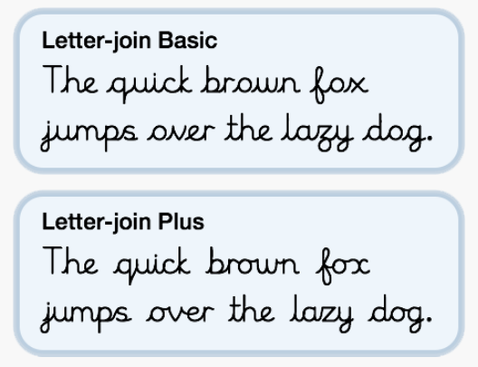
Handwriting
The expectation now is that all children from Year 2 upwards will use joined handwriting.
We use the ‘Letter Join’ website and there is the potential to allow access to this website at home.

Slide 6
Spelling, Punctuation and Grammar
Children need to be able to spell all the words on the curriculum lists. They are available in the classroom for children to take home. Weekly tests will be based on these lists.
Grammar and punctuation is tested in one dedicated paper. The spelling score is out of 20 – a huge proportion of the test score.
Year 6 guides can be purchased online easily. The technical terms need to be learnt.
Spellings will be sent out on Friday for the test on the following Wednesday. Part of the homework will be to write these spelling in cursive joined handwriting.
Lists and games are available on Spellingframe.

Slide 7
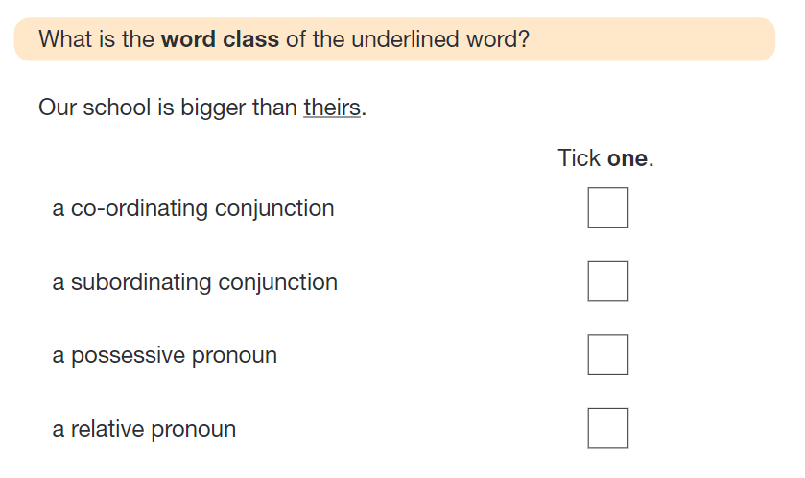

Slide 8
How to Help Your Child with Writing
Practise and learn weekly spelling lists – make it fun! Use different strategies – pyramids, no vowels, blocking, speed writing etc.
Encourage opportunities for writing such as letters to family or friends, shopping lists, notes or reminders, stories and poems.
Write together – be a good role model for writing.
Encourage use of a dictionary to check spelling and a thesaurus to find synonyms and expand vocabulary.
Allow your child to use a computer for word processing, which will allow for editing and correcting of errors without lots of crossing out.
Remember that good readers become good writers! Identify good writing features when reading (e.g. vocabulary, sentence structure and punctuation).
Show your appreciation: praise and encourage, even for small successes!

Slide 9
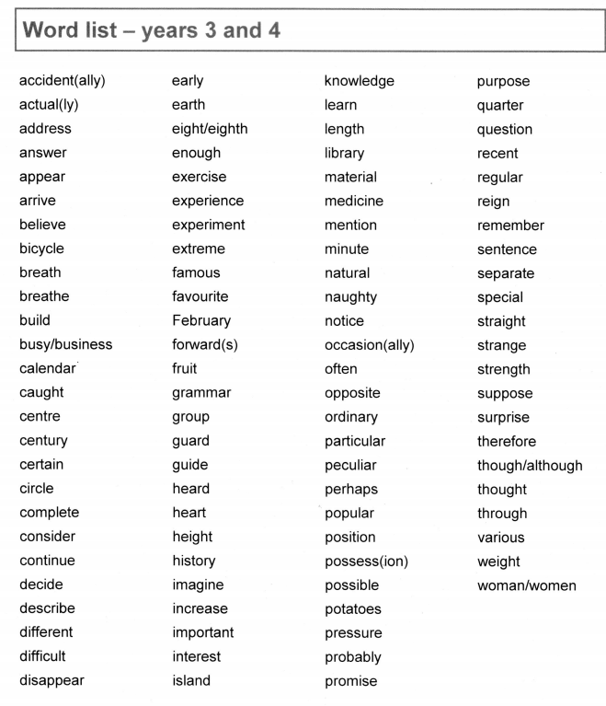

Slide 10
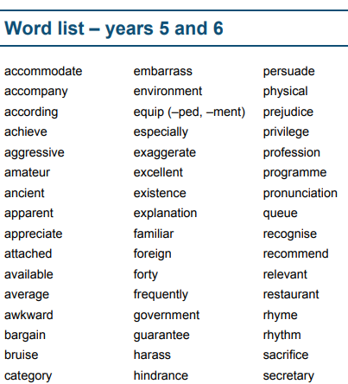

Slide 11
Reading
It is essential that all children read something every evening. This can include magazines, comics or newspapers rather than traditional books. Reading ability is like a muscle in that it needs to be exercised.
In Year 6 children need to expand their vocabulary. Reading challenging texts is a good way to do this as long as the words are explained to the child.
We will be checking reading records on a Friday and we expect the children to have read at least five times in the week and they should have added a non-generic comment.
Reading Records need to be in daily.

Slide 12
How to Help Your Child with Reading
Listening to your child read can take many forms.
First and foremost, focus developing an enjoyment and love of reading.
Enjoy stories together – reading stories to your child at KS1 and KS2 is equally as important as listening to your child read.
Read a little at a time but often, rather than rarely but for long periods of time!
Talk about the story before, during and afterwards – discuss the plot, the characters, their feelings and actions, how it makes you feel, predict what will happen and encourage your child to have their own opinions.
Look up definitions of words together – you could use a dictionary, the Internet or an app on a phone or tablet.
All reading is valuable – it doesn’t have to be just stories. Reading can involve anything: fiction, non-fiction, poetry, newspapers, magazines, football programmes and TV guides.
Visit the local library - it’s free!

Slide 13
Maths
Times tables are expected to be learnt by the end of Year 4.
Children need to quickly respond to formal calculations in the arithmetic test so they need to be confident when using numbers.
The reasoning paper covers all areas of maths so children need to apply their learning. It’s not a reading test so questions can be read if the child requests it.
Asking children how they found the answer is a good way of gauging what they understand.

Slide 14
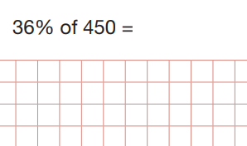
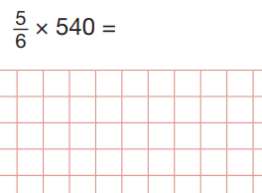
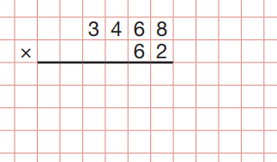

Slide 15
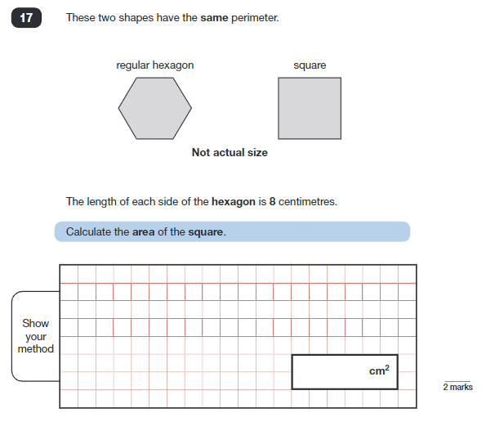

Slide 18
How to Help Your Child with Maths
Play times tables games.
Play mental maths games including counting in different amounts, forwards and backwards.
Encourage opportunities for telling the time.
Encourage opportunities for counting coins and money; finding amounts or calculating change when shopping.
Look for numbers on street signs, car registrations and anywhere else!
Look for examples of 2D and 3D shapes around the home.
Identify, weigh or measure quantities and amounts in the kitchen or in recipes.
Play games involving numbers or logic, such as dominoes, card games, darts, draughts and chess.

Slide 19
How to Help Your Child with Maths
Know all the times tables facts up to 12 x 12
Use these facts to know some division facts:
E.g. 9 X 11 = 99 so 99 ÷ 9 = 11
Know their number bonds to 10, 100 and 1
E.g. 2 + 8 = 10 so 20 + 80 = 100 and 0.2 + 0.8 = 1
3 + 7 = 10 so 30 + 70 = 100 and 0.3 + 0.7 = 1
45 + 55 = 100
Can your child tell the time correctly and calculate how long something lasts?
Do they know how to use a calendar and how many days there are in each month?

Slide 20
How to Help Your Child
First and foremost, support and reassure your child that there is nothing to worry about and they should always just try their best. Praise and encourage!
Ensure your child has the best possible attendance at school.
Support your child with any homework tasks.
Reading, spelling and arithmetic (e.g. times tables) are always good to practise.
Talk to your child about what they have learnt at school and what book(s) they are reading (the character, the plot, their opinion).
Make sure your child has a good sleep and healthy breakfast every morning!

